Slide 1
TMDGen
Nuruzzaman Sakib
Department of Mechanical Engineering, University of Alabama, Tuscaloosa, AL

Slide 2
TMDGen
Introducing TMDGen: Your Gateway to WSe₂ Monolayer Grain Boundary Structures
Welcome to TMDGen, a software for 2D TMDC materials science research, Designed by Nuruzzaman Sakib and Kasra Momeni.
TMDGen empowers scientists and engineers to explore the fascinating world of WSe₂ monolayer grain boundary structures with unparalleled ease and precision. This innovative software utilizes computational techniques to create highly realistic and customizable simulations, offering an invaluable platform for studying the behavior and properties of these essential materials.
Whether you are a seasoned researcher or a budding enthusiast, TMDGen can help you generating complex WSe₂ monolayer grain boundary structures, accelerating scientific discovery and advancing our understanding of these remarkable materials.

Slide 3
TMDGen
Readme.txt
Installation:
First run "python3 setup.py build_ext --inplace" in a terminal with "Codes" directory as current directory to create the _cGBUtils module created by Ashivni Shekhawat et al. Cite as - "Large-scale experimental and theoretical study of graphene grain boundary structures, Colin Ophus, Ashivni Shekhawat, Haider Rasool, and Alex Zettl, Phys. Rev. B 92, 205402“
Prerequisites:
Install NumPy (pip3 install numpy)
Install ASE (pip3 install ase)
Install ovito using (pip3 install ovito)
Install LAMMPS (See LAMMPS website on how to install)
Instruction for use:
Change the bash file "TMDGen.sh" according to the Grain Boundary misorientaion angle. Just change the "r1","r2", "cell_width".
run bash TMDGen.sh from outside of Codes directory. Do not change the folder and TMDGen location. If you do, then change the bash script as well to accommodate the change.
After that, you need to run energy minimization of the created TMDC GB structure before use in LAMMPS calculation.

Slide 4
Modules
_cGBUtils.c
setup.py
grainBdr.py
structure_gen.py
This code can generate the GBs for graphene with pentagon-heptagons only. Which is the common defect type in GBs found in CVD grown graphene structures.
For better understanding of this portion of code, please read - "Large-scale experimental and theoretical study of graphene grain boundary structures, Colin Ophus, Ashivni Shekhawat, Haider Rasool, and Alex Zettl, Phys. Rev. B 92, 205402"

Slide 5
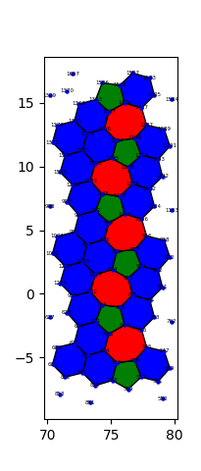
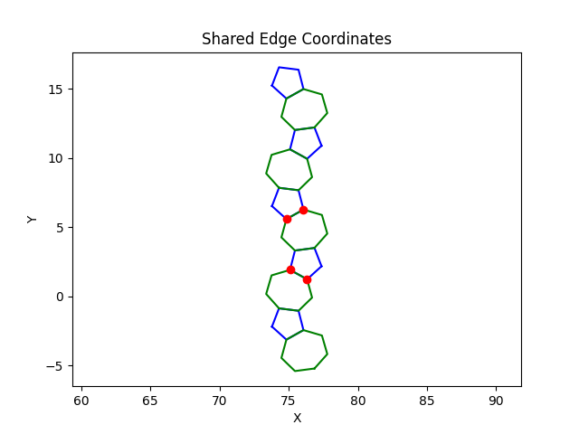
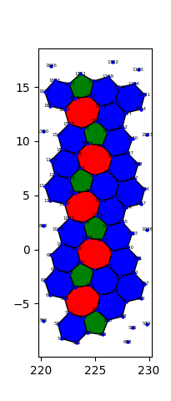
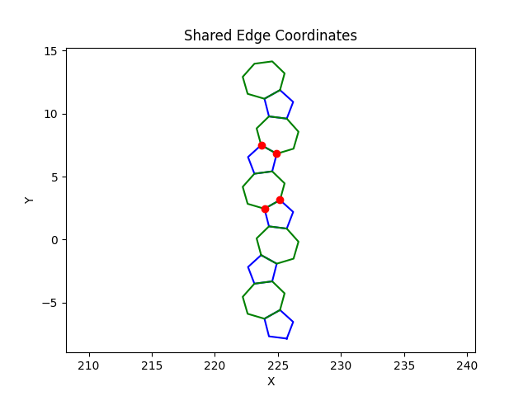
Modules
in.min
  This is simple lammps script to minimize the structure generated by Ashivni et al.
ovito_data_extract.py
  This python code imports ovito python library and can generate neighbor list based on cutoff distance (here we used 1.60 A for graphene).
identify_penta_hepta.py
  Based on the neighbor list, this code can find the pentagons and hexagons of the structure.
  It also identify the pentagon-heptagon pair in the GB.
shared_edge.py
  This code can identify the shared edge between a pentagon-heptagon pair and output the atom IDs of the shared edge in the “same_atom.txt” file.
type_assign.py
  This code can assign the type of atoms for the coordinates and can transform the mono-layer-mono-atomic graphene GB structure to tri-layer-bi-atomic WSe₂ GB structure.

Slide 6
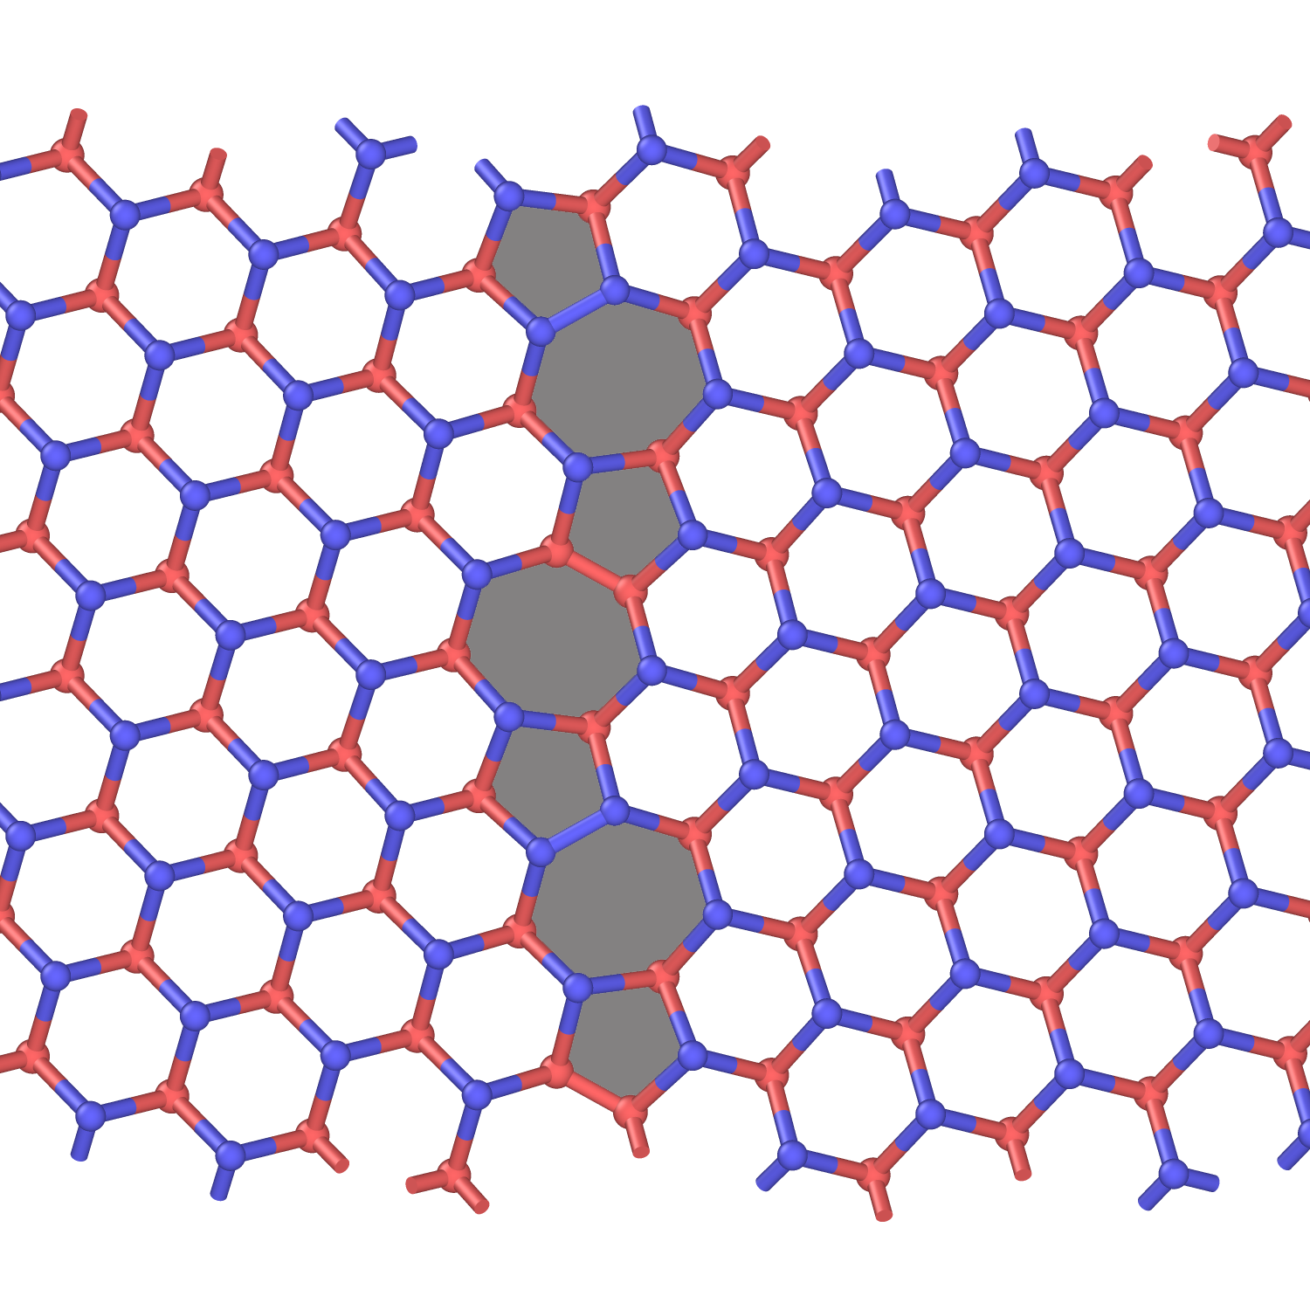
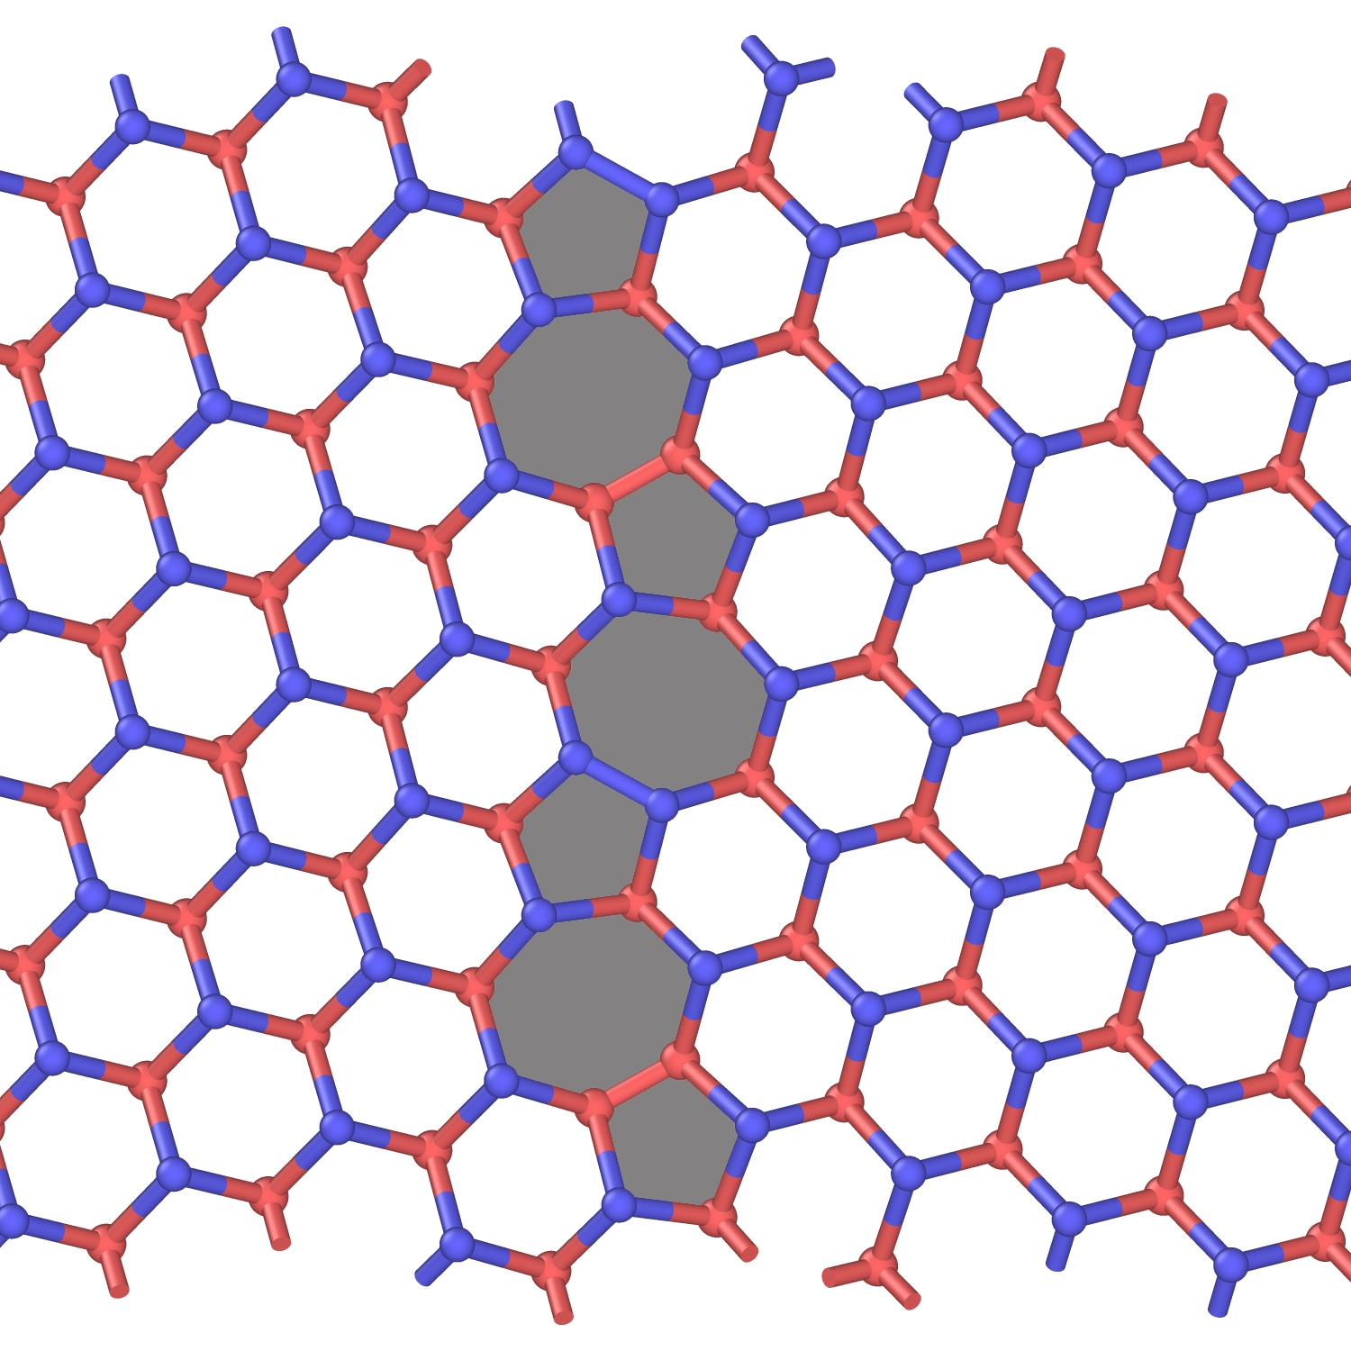
Output
Se-Se
W-W
W-W
Se-Se

Slide 7
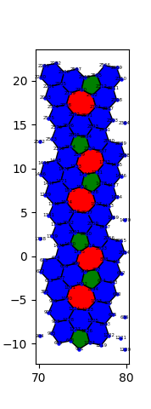
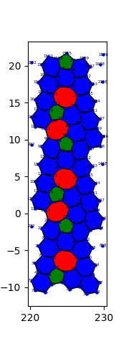
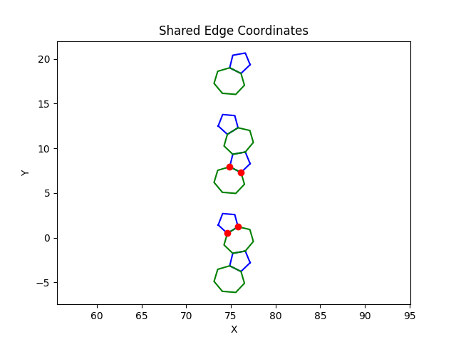
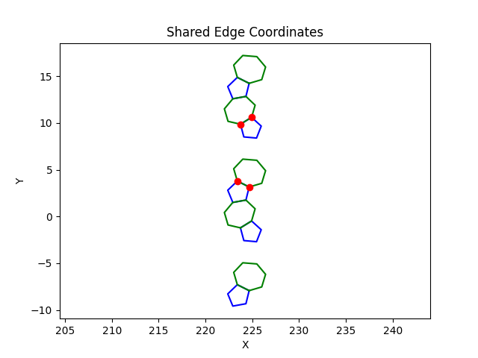
Extra Slides

Slide 8
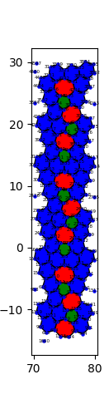
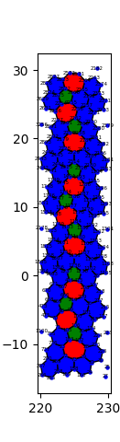
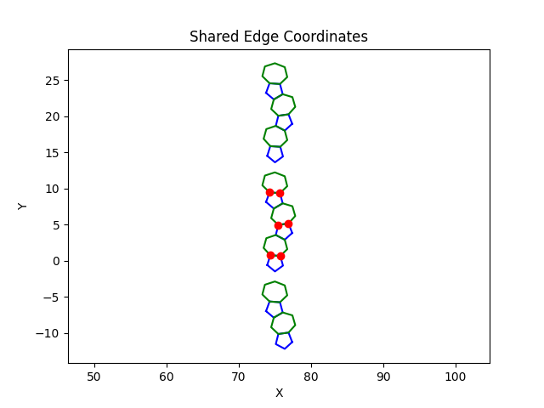
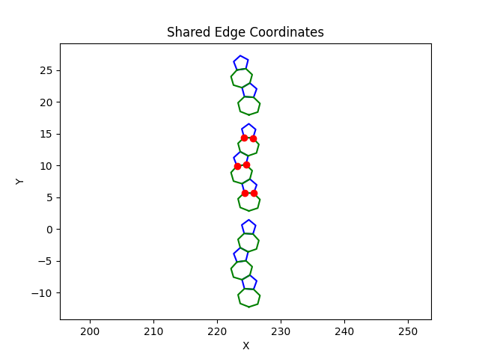
Extra Slides

Slide 9
Thank You

